Slide 1
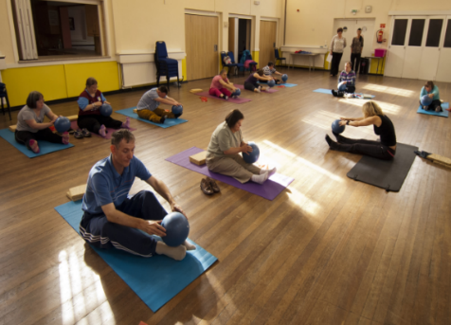
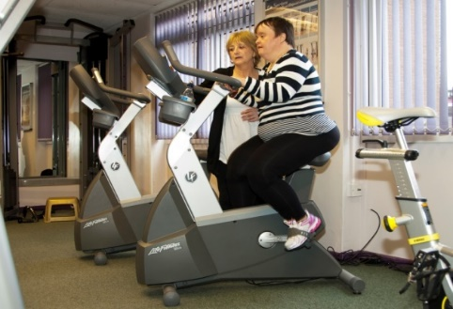
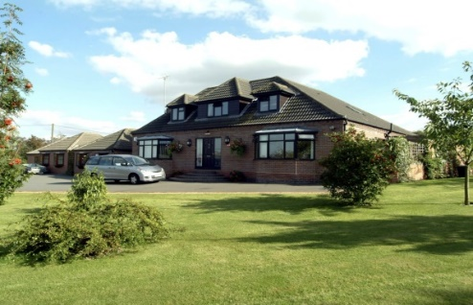
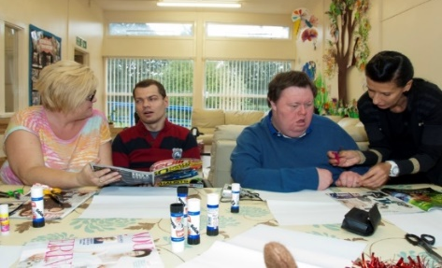
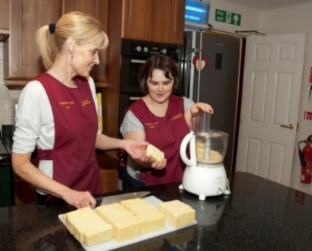
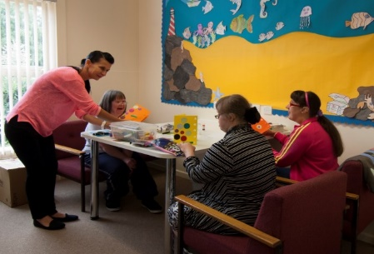
COME ALONG TO OUR RECRUITMENT EVENT
If you are caring, compassionate, patient & motivated, we could have the career for you!
Come and join us for light refreshments & the opportunity to meet staff
& service users to learn more about becoming a support worker or volunteer
THURSDAY 26TH SEPTEMBER
11am – 1pm
POLESWORTH MEMORIAL HALL
Full & part time positions available
Excellent terms & conditions
Rewarding career
Low staff turnover levels
Full training provided
We are a local registered charity that has been operating since 1982
providing accommodation and support to adults with a learning disability across our services based in the Polesworth, Dordon and Atherstone area.
We support and encourage service users to actively engage in the life of the local community to enable them to lead full and independent lives using local community facilities, whilst ensuring that they are secure and safe from any kind of abuse, neglect or exploitation.
Tel: 01827 896124 website: www.polesworthhomes.co.uk

